Slide 1
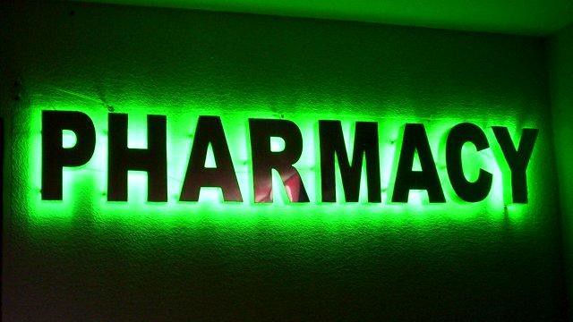

Introduction of Pharmacy
Presented by shahariyan
This Photo by Unknown author is licensed under CC BY-SA-NC.

Slide 2
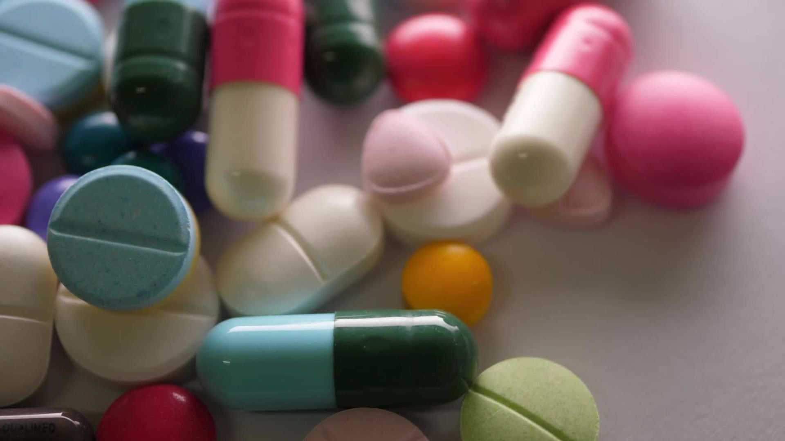

Drug
Definition :According to WHO , any subtances that are used to modify or explore physical systems or pathological states for the benefits of the recipient .
SOURCES OF DRUGS :
NATURAL SOURCE | SSYNTHATIC SOURCE | SEMI SYNTHETIC SOURCE
Vegatable source Animal source Mineral source Microbiological source | Inorganic source Organic source Combination source | By altering structers of naturally occuring drugs

Slide 3

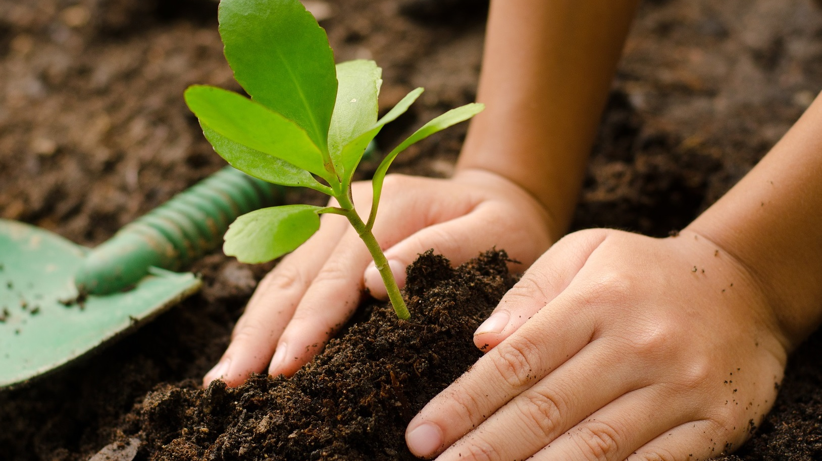
Sources of drugs
Vegatables or plants source
Oldest of all
Various parts of plants like-leaves, flowers, seeds, roots, stems & bark etc. are used
e.g. – Belladonna leaves, Belladonna roots, Cinchona bark, Digitalis leaves, Nux vomica seeds, seed head of unripe opium poppy etc.

Slide 4
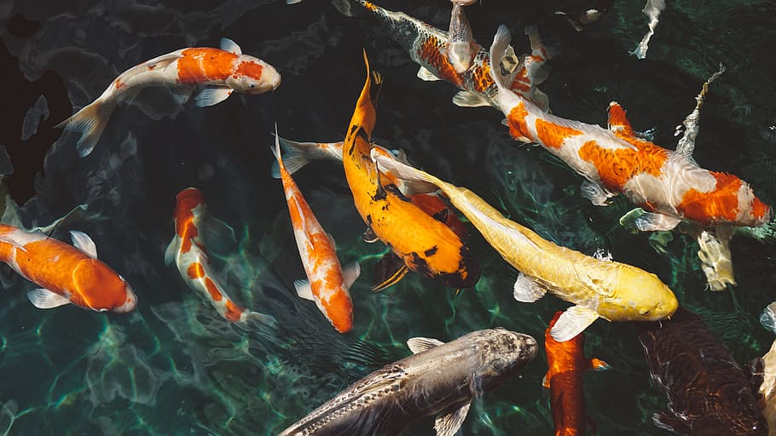
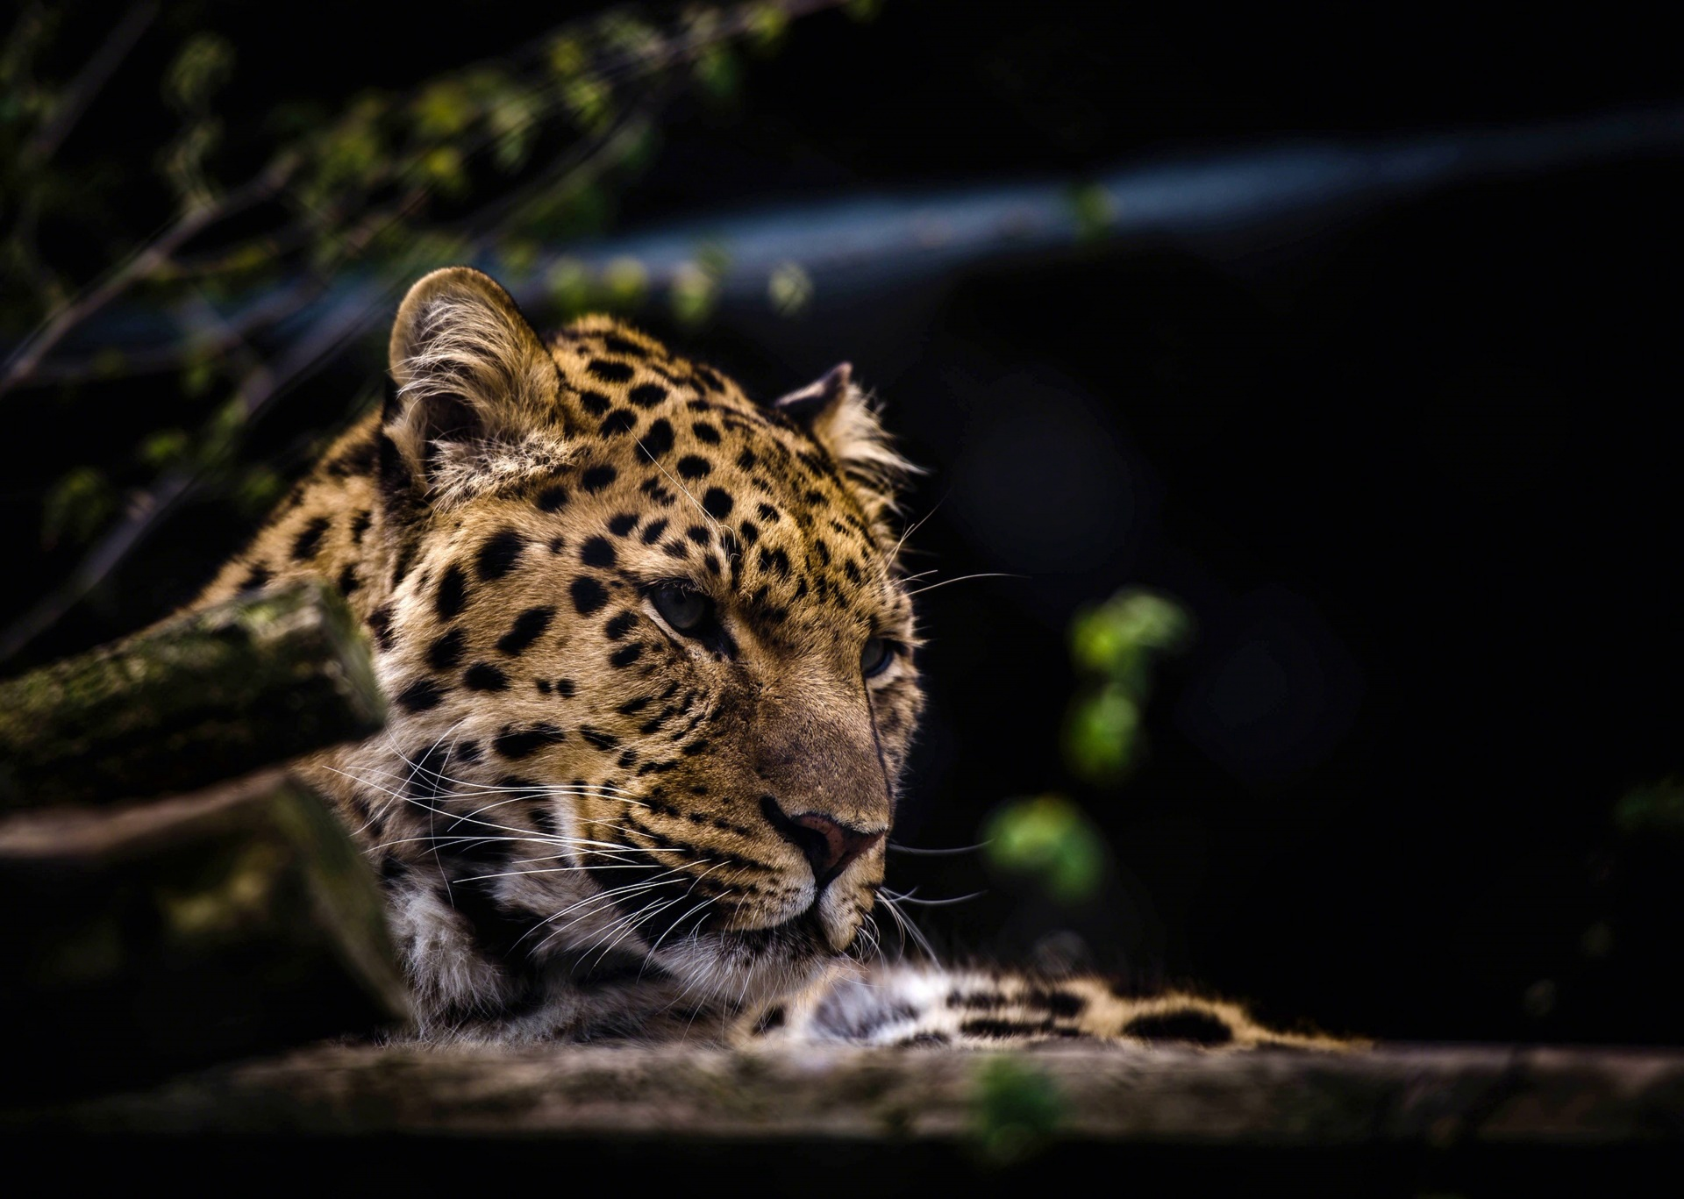
Animal source
Past Days
Dried toad skin - for treatment of tooth ache, gum bleeding (China)
•Cod fish - Cod liver oil source of Vit. A & D
Sheep thyroid is a source of thyroxin, used in hypertension
Present Days
Insulin from pork (porcine), Cow & buffalo (bovine)
IgG is prepared by injecting specific antigens to different animals which is later used as vaccines (antiserum)
hMG (human menopausal gonadotropin) from post menopausal women urine contain mixture of FSH & LH
hCG (human chorionic gonadotropin) produced by placenta, obtained from pregnant woman’s urine

Slide 5
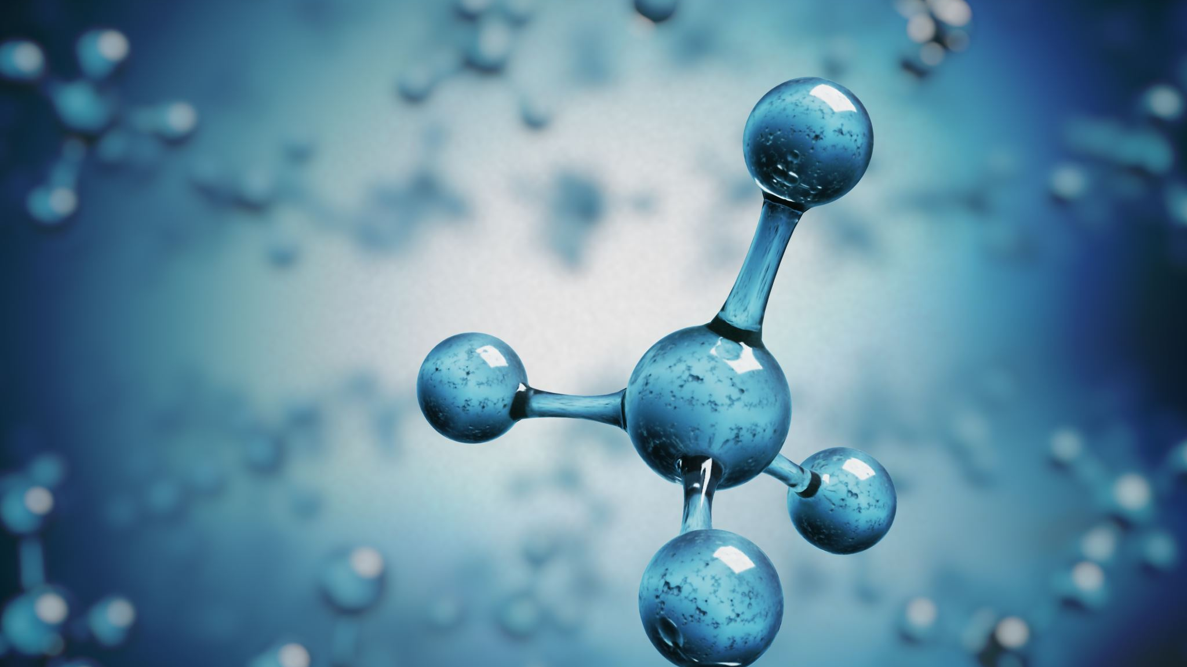
Mineral source
i. Metallic and Non metallic sources
Iron is used in treatment of iron deficiency anemia.
Mercurial salts are used in Syphilis.
Zinc is used as zinc supplement. Zinc oxide paste is used in wounds and in eczema.
Iodine is antiseptic. Iodine supplements are also used.
Gold salts are used in the treatment of rheumatoid arthritis.
ii. Miscellaneous Sources
Fluorine has antiseptic properties.
Borax has antiseptic properties as well.
Selenium as selenium sulphide is used in anti dandruff shampoos.
Petroleum is used in preparation of liquid paraffin.

Slide 6
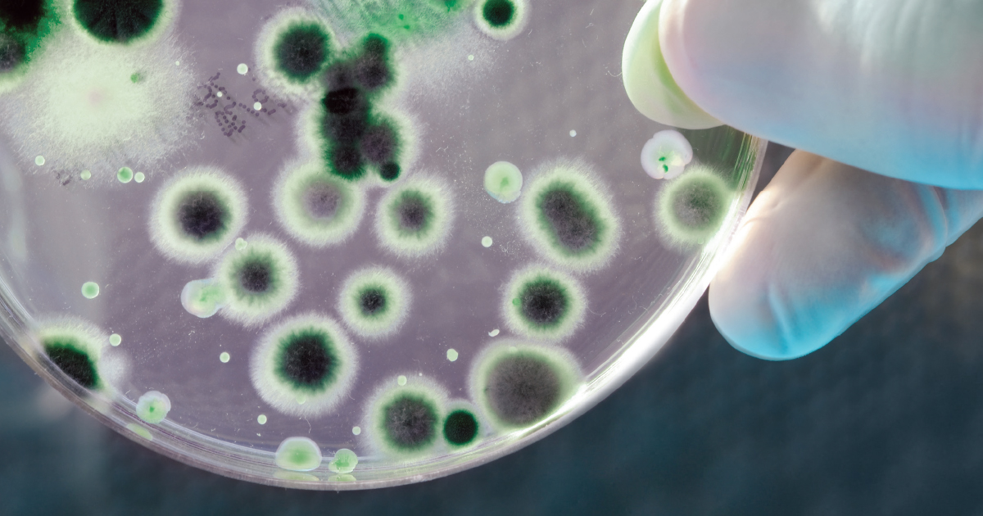
Microbiological source
Many antibiotics are isolated from different fungi etc.
Example-
- Penicillin from Penicillum notatum
- Erythromycin from Streptomyces erythreus
- Streptomycin from Streptomyces griseus
- Cephalosporins from Cephalosporium acremonium
- Tetracycline from Streptomyces aureofaciens
This Photo by Unknown author is licensed under CC BY.

Slide 7
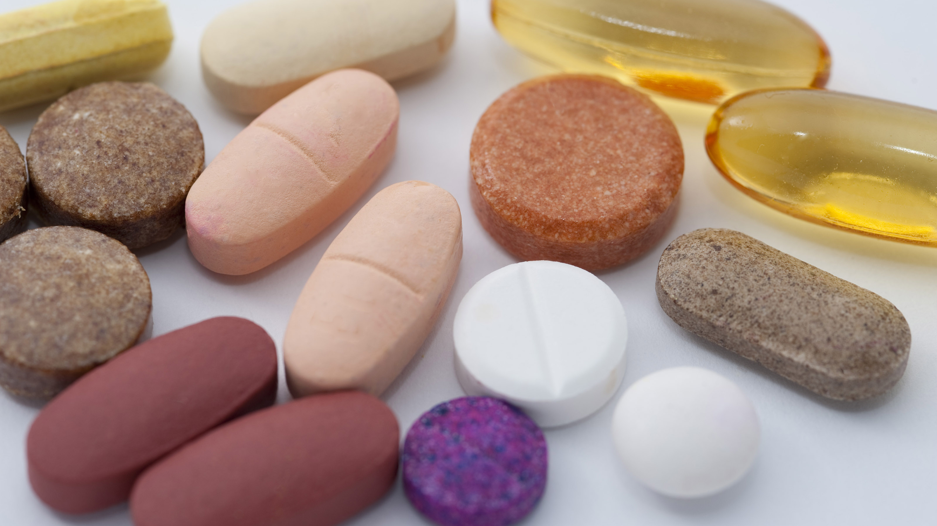
Synthetic source
Organic
Inorganic
Combination of these two
Latest of all
Drugs are produced in laboratory or in pharmaceutical industry
Drugs are more potent and effective Free of many impurities
This Photo by Unknown author is licensed under CC BY.

Slide 8
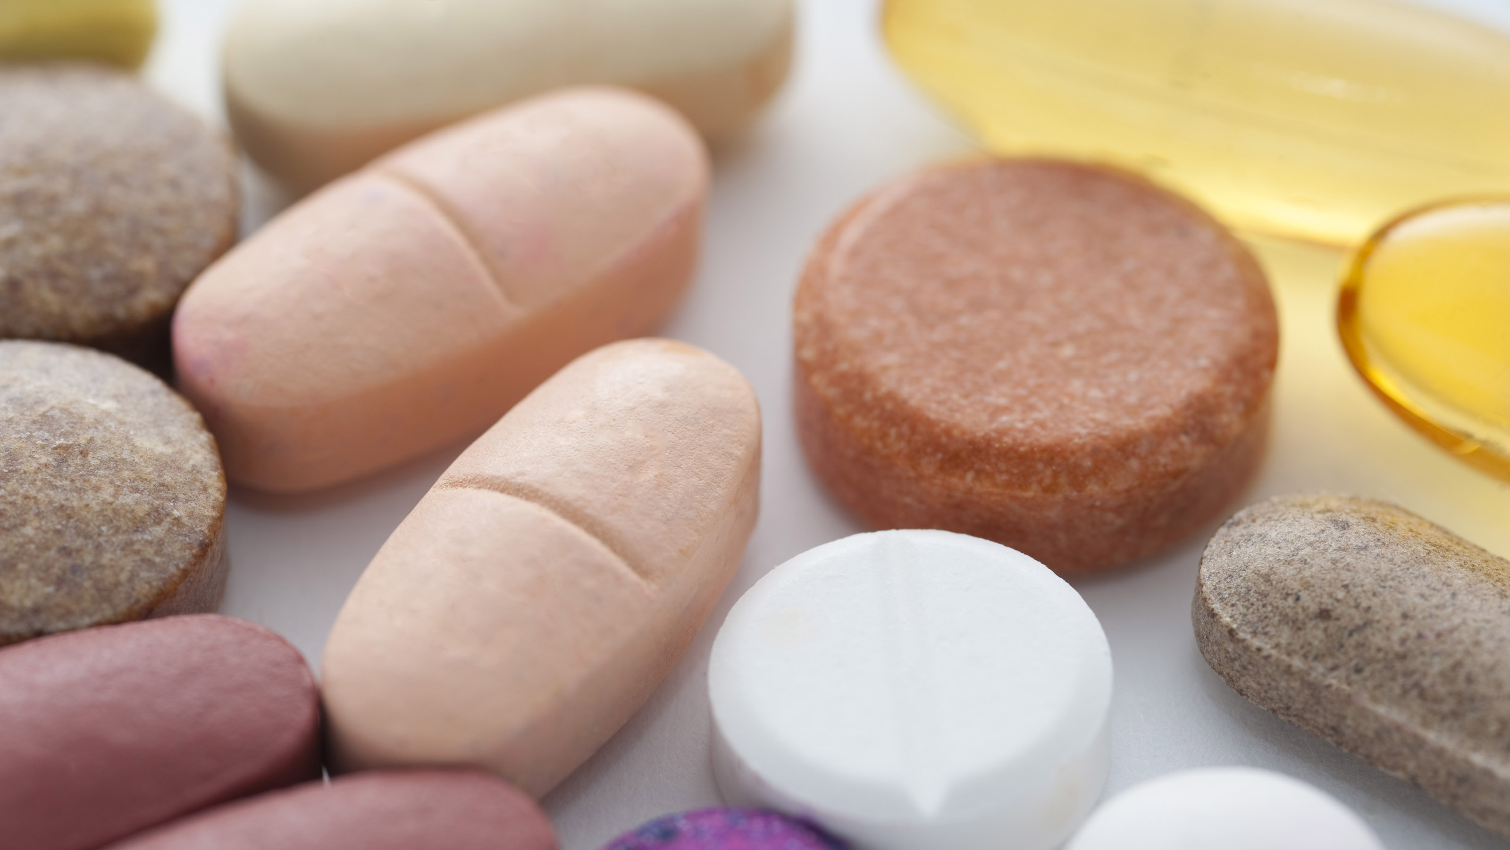
Semi synthetic source
Some of the drugs are altered structurally in the laboratory to get newer agents with less adverse effects, prolonged duration of action and better pharmacological actions
Ampicillin, Amoxycillin are semisynthetic Penicillins.
Heroin is obtained from Morphine
This Photo by Unknown author is licensed under CC BY.

Slide 9
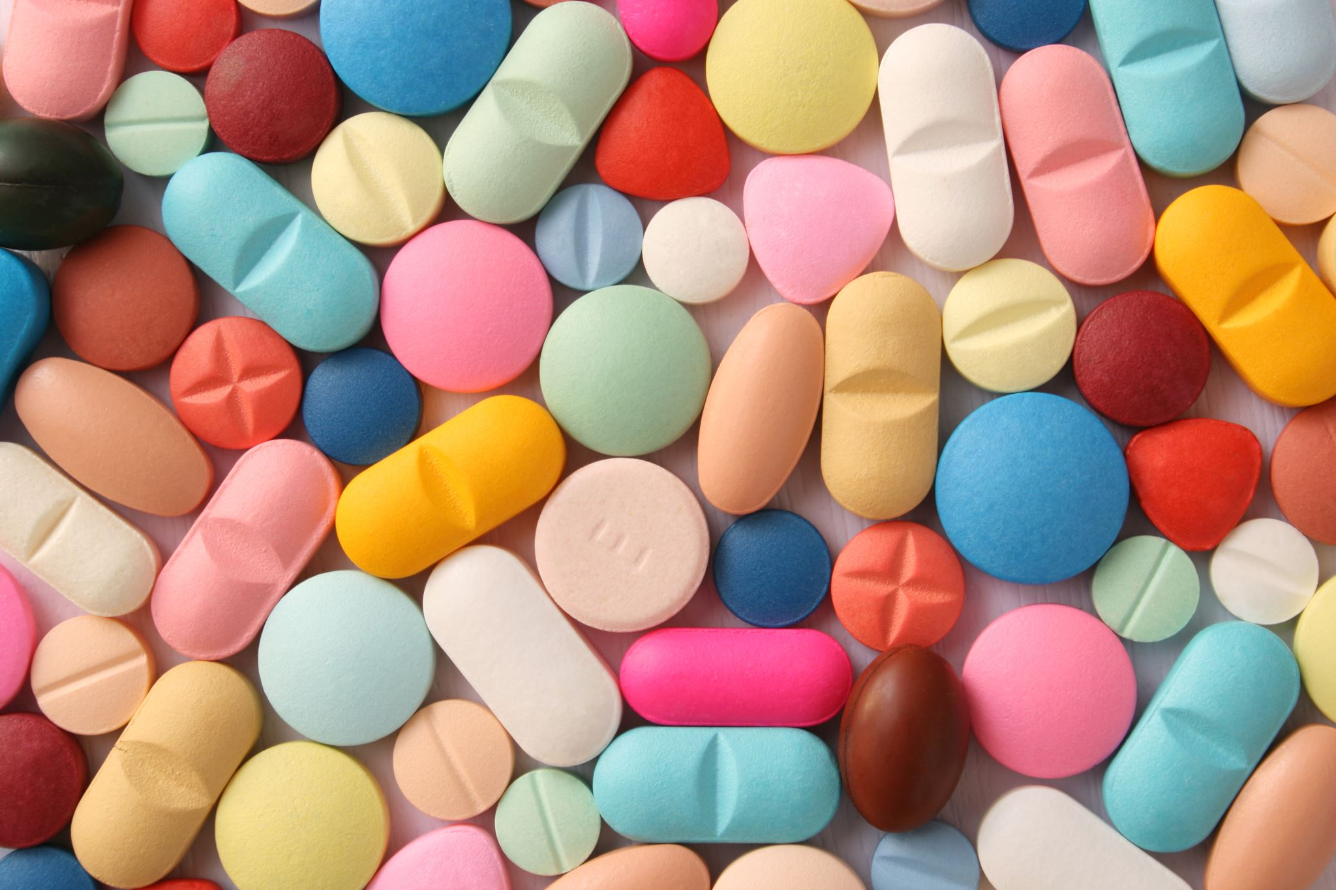
Types of drugs
rude drugs • Non-official drugs • Official drugs • Un-Official drugs • INN • OTC drugs • Me-too drugs | •Legend / Prescription drugs • Narcotic drugs • Misbranded drugs • Thermolabile drugs • Biological drugs • Non-biological drugs

Slide 10
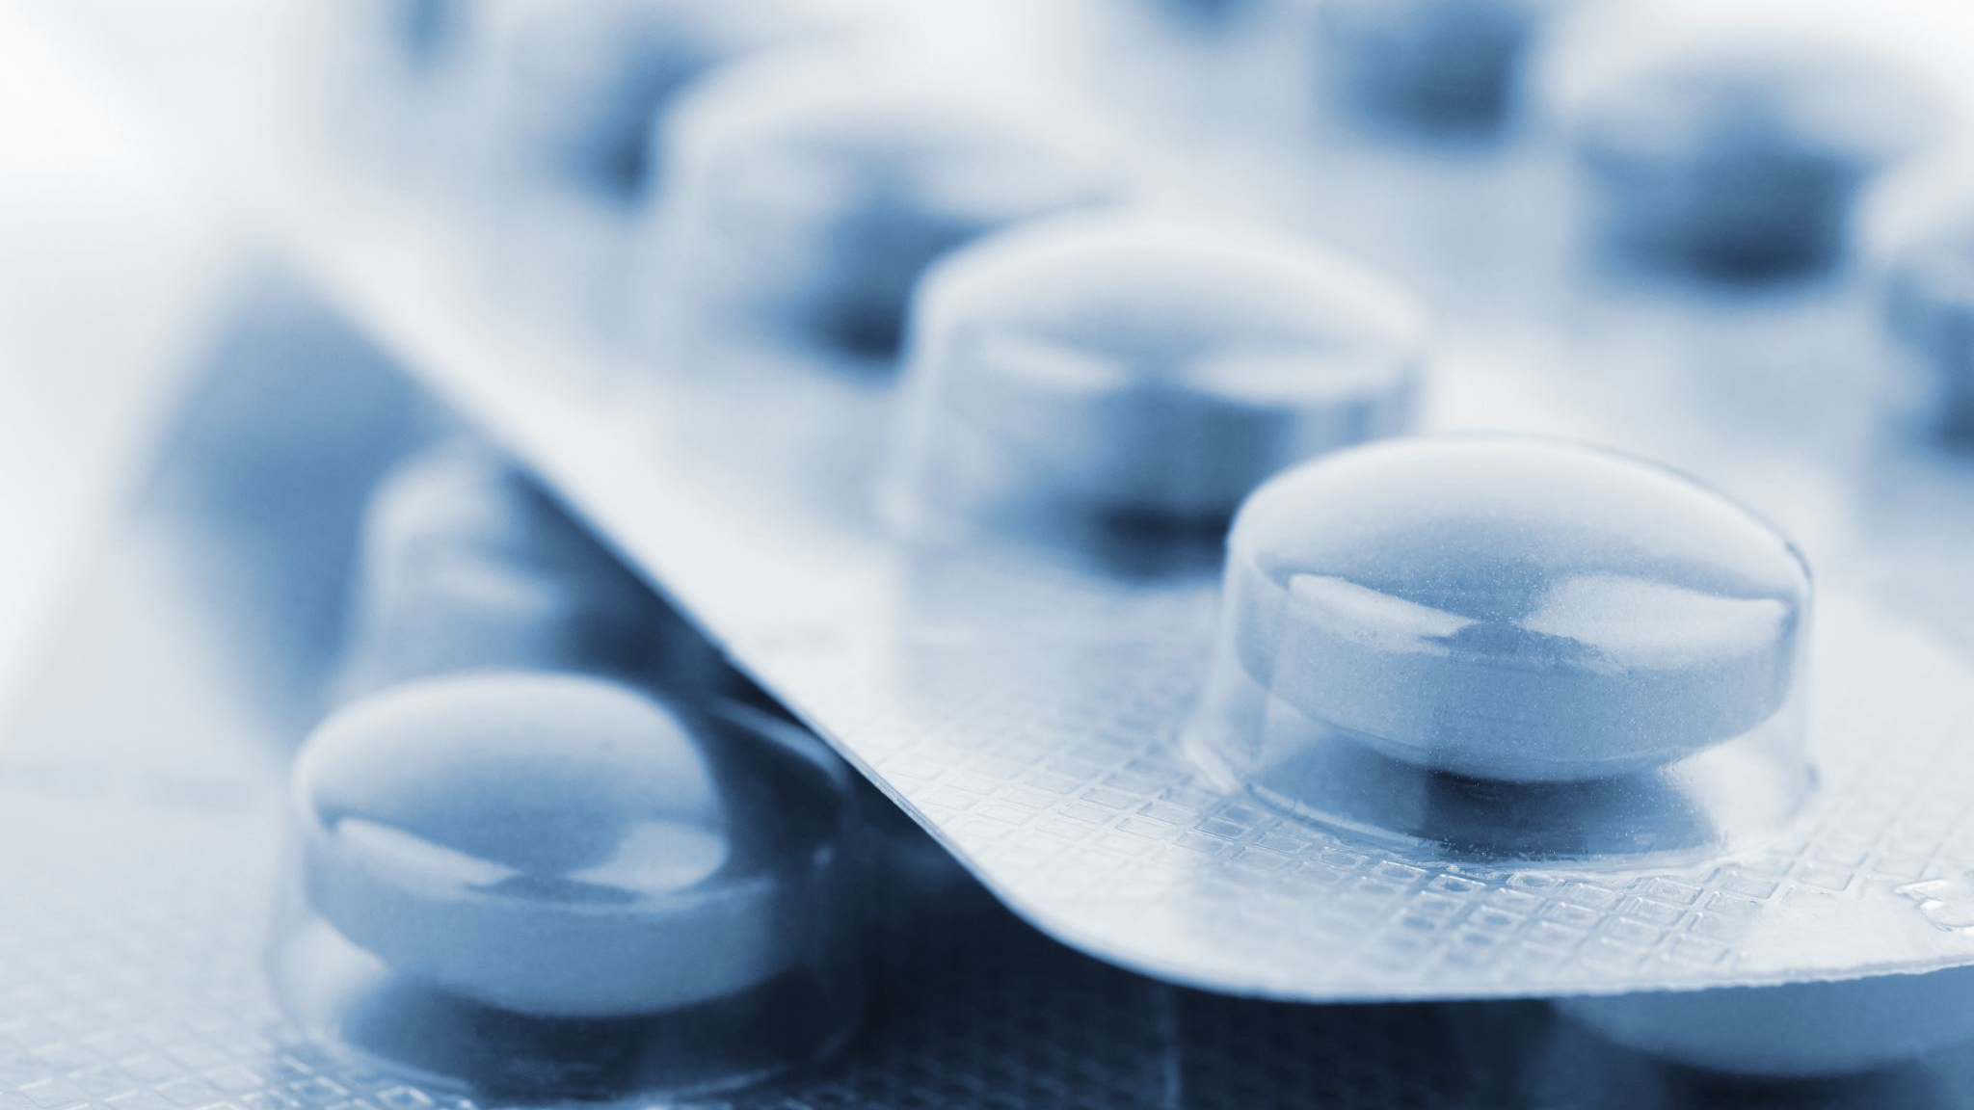
medicine
Medicine is any drug, which has definite dose and dosage form and is used to treat or prevent diseases in man or animal.
Example: Paracetamol 500mg tablet, Amoxicillin 250mg capsule
 Counterfeit Medicine
Essential
Detailed from ‘Fundamentals of Pharmacy & Pharmacy Practices’ by M.A. Mazid & M.A. Rashid

Slide 11
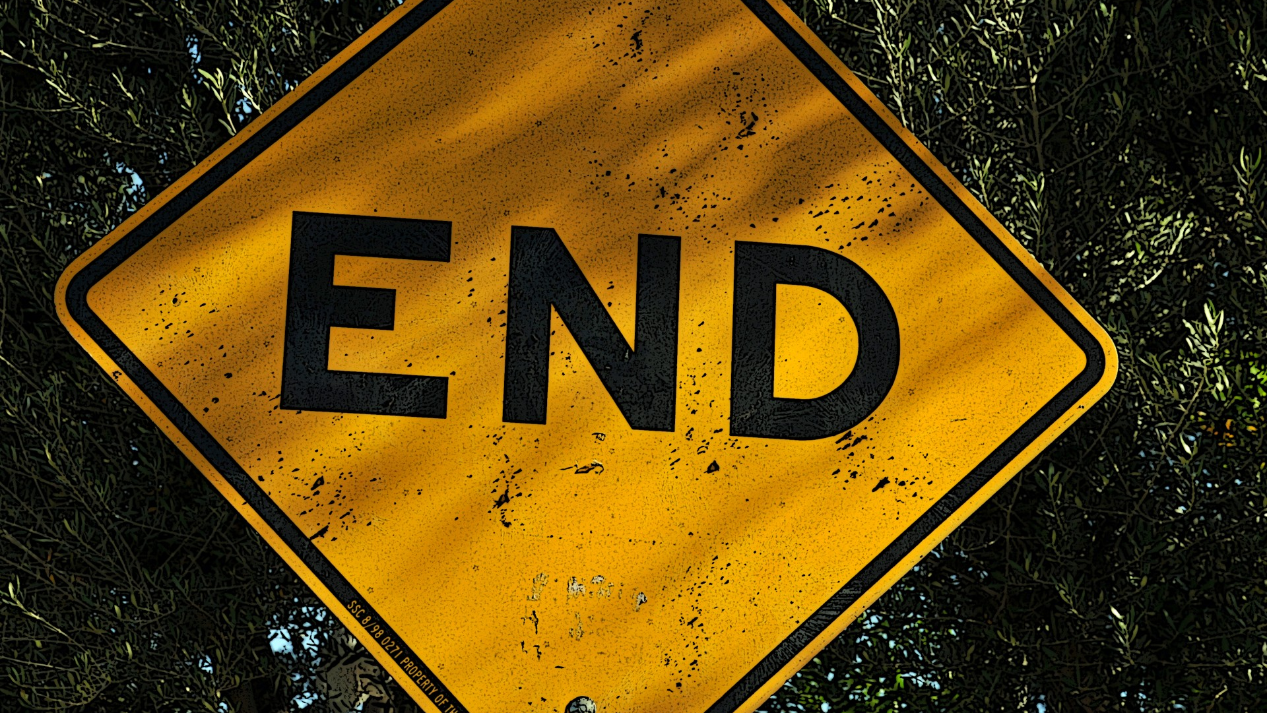
THE END

